Slide 1
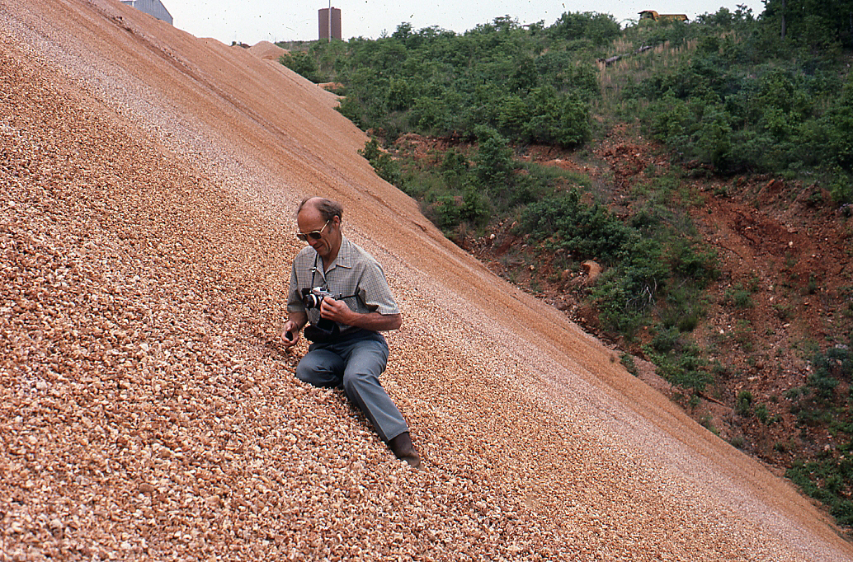
The Life and Times of James Hadley Williams, Ph.D.

Slide 2
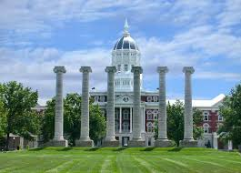
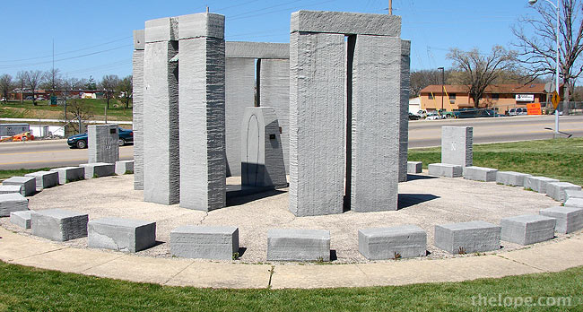
Education

Slide 3
Academic Honors
Phi Eta Sigma
Gamma Alpha
Sigma Xi
Phi Kappa Phi
Certificates of Appreciation, AEG 1975 & 1979
DNR Employee of the Year 1981
AIPG Presidential Merit Award 1996
John T. Galey Service Award 2000

Slide 4
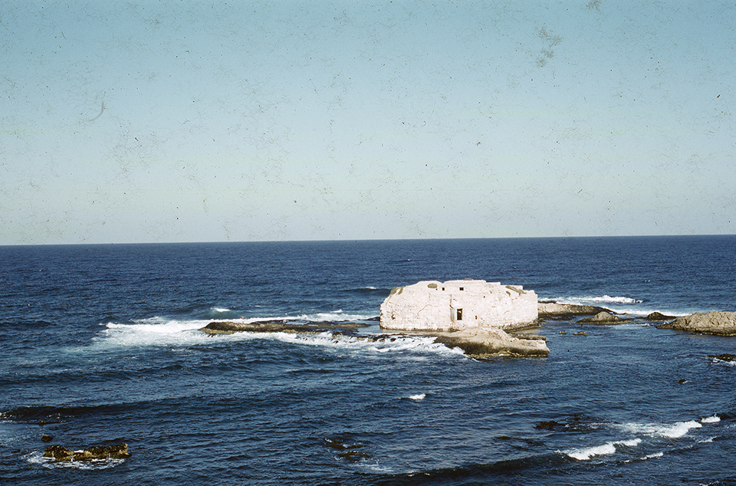
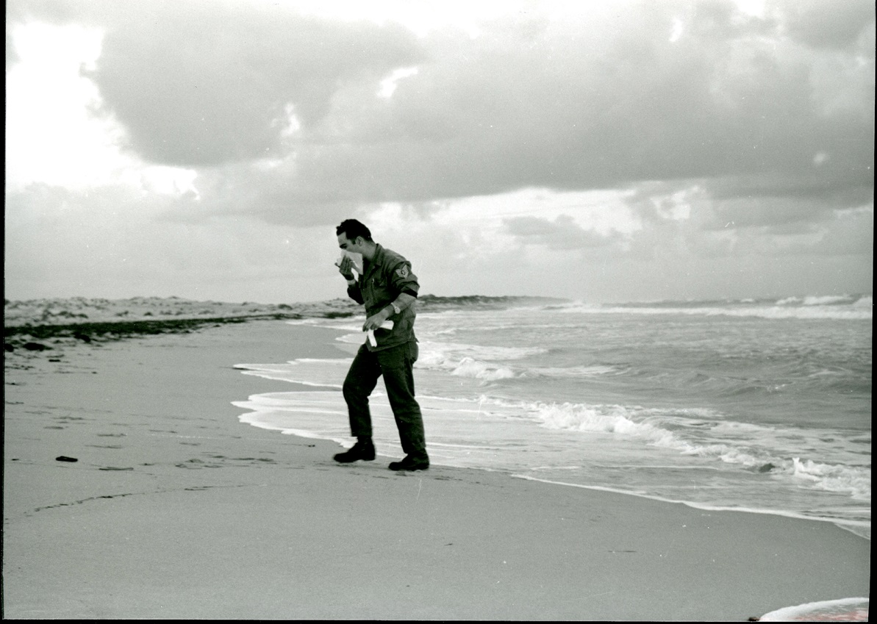
Military Service U.S. Air Force 1954-1959

Slide 5
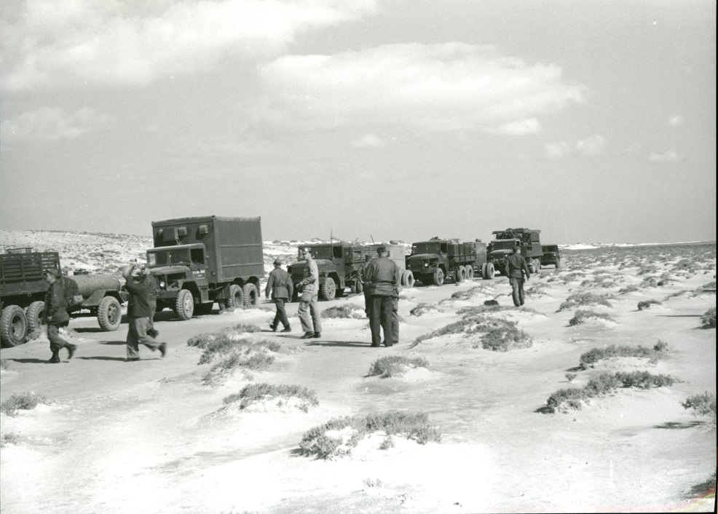
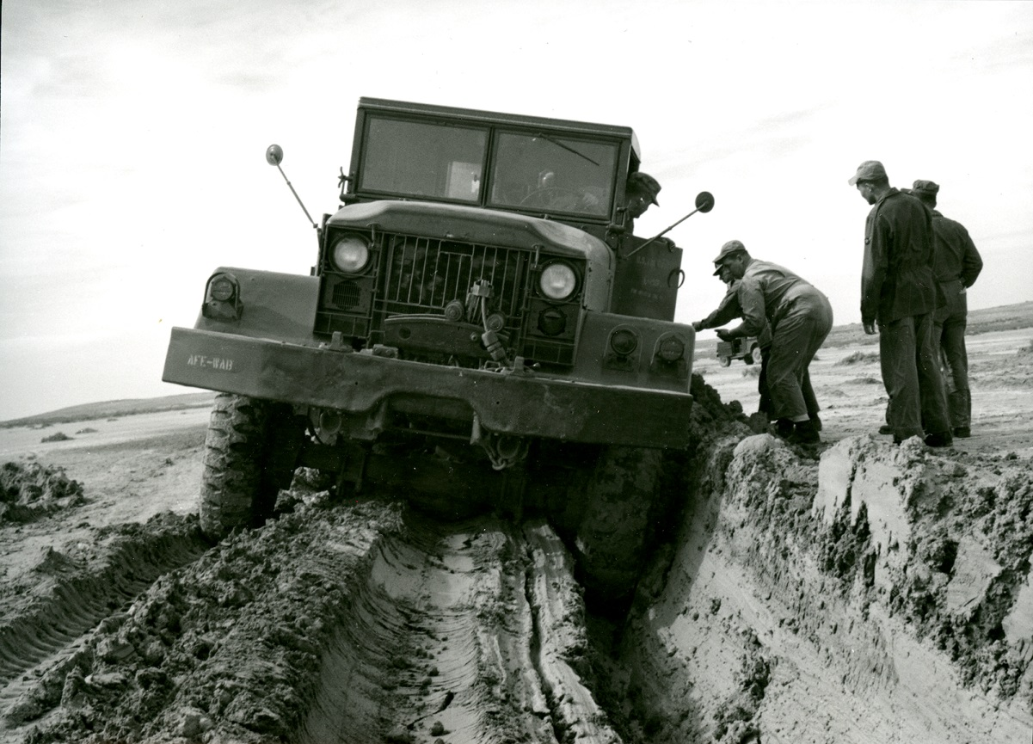
Military Service U.S. Air Force 1954-1959

Slide 6
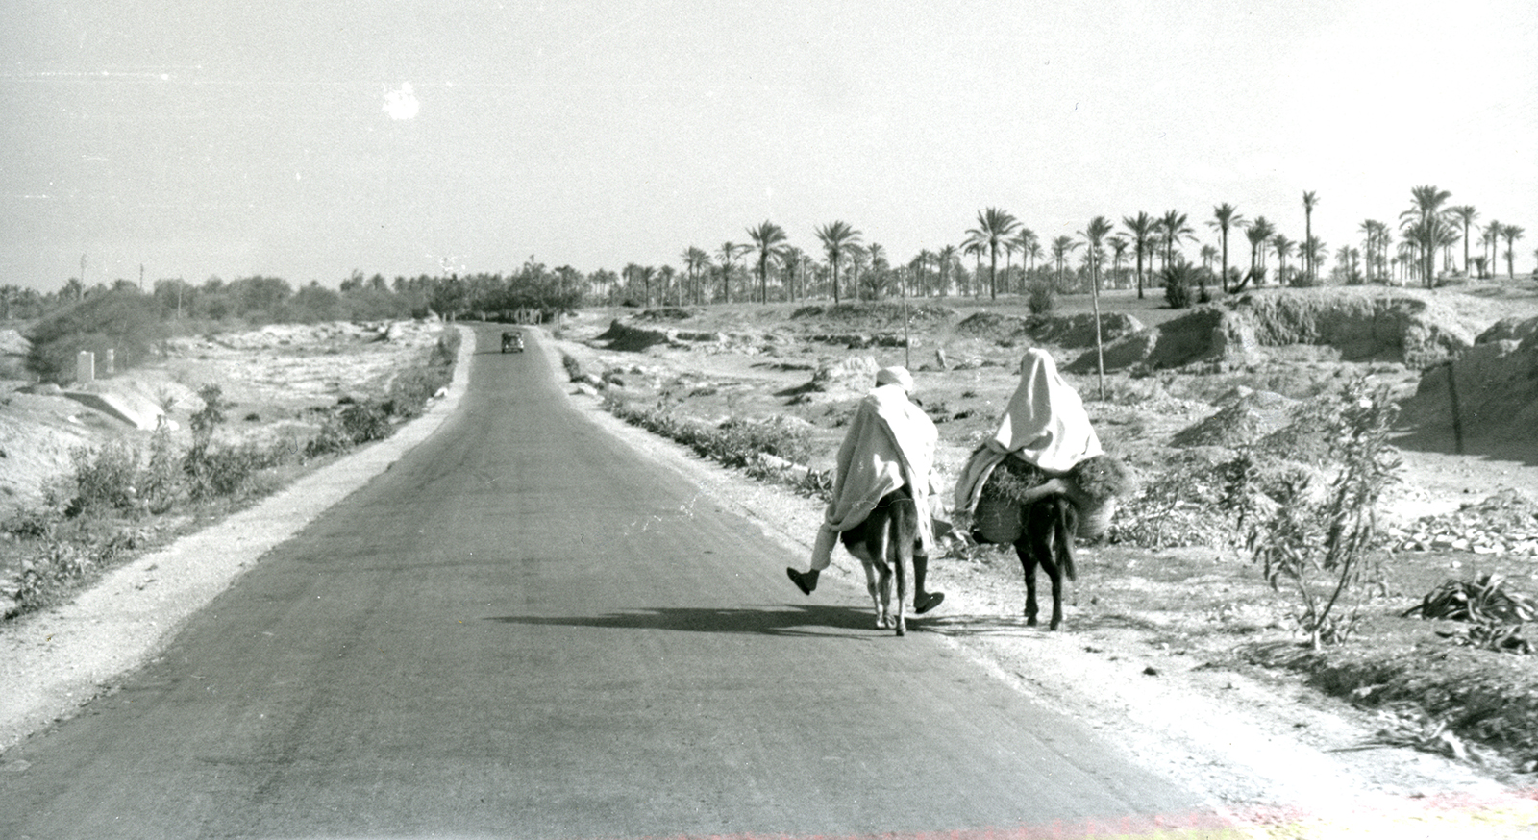
Military Service U.S. Air Force 1954-1959

Slide 7
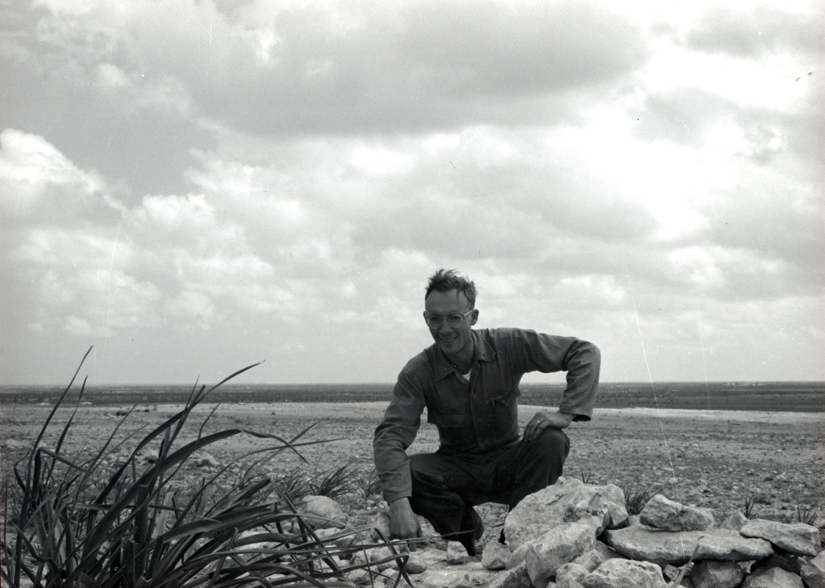
Military Service U.S. Air Force 1954-1959

Slide 8
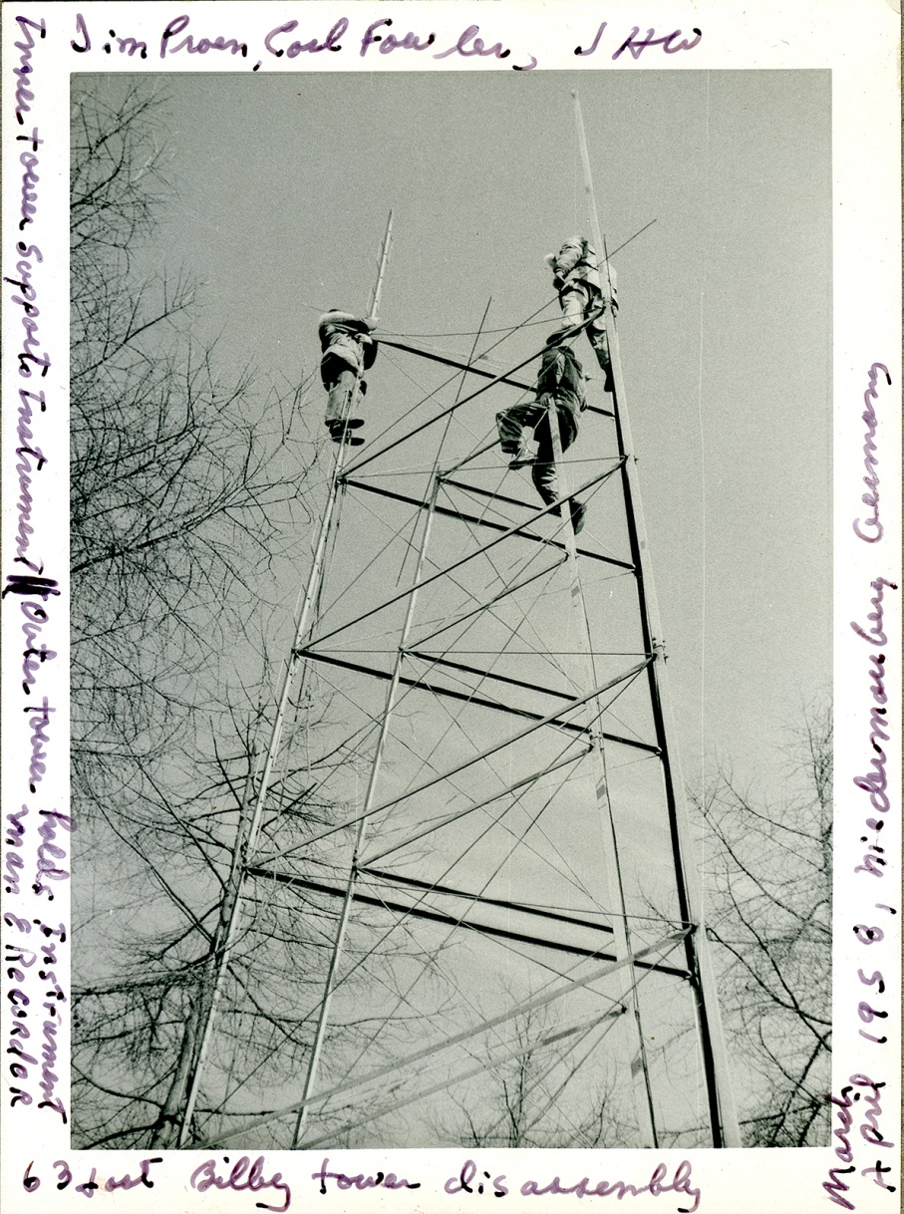
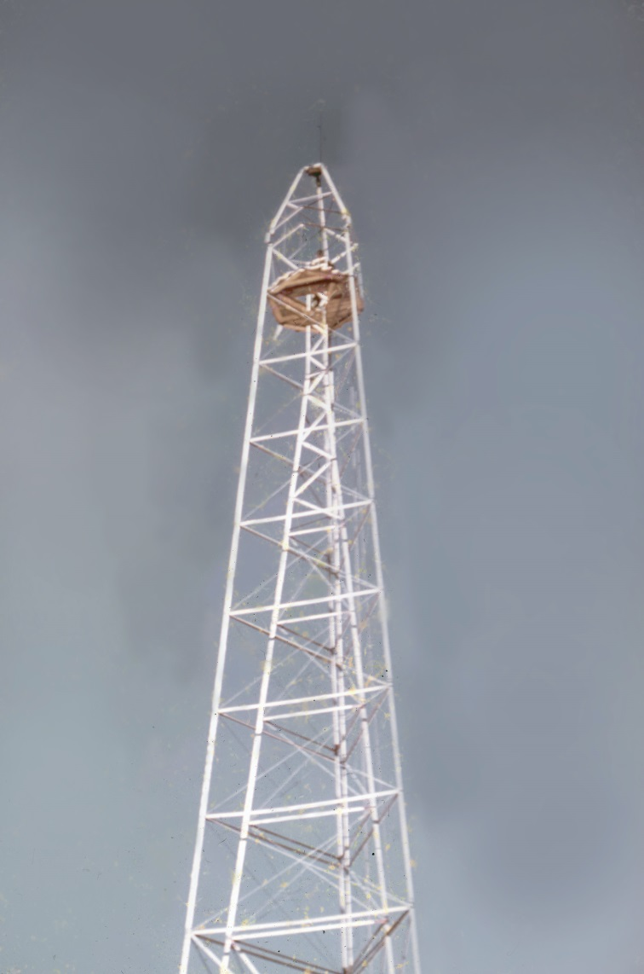
Military Service U.S. Air Force 1954-1959

Slide 9
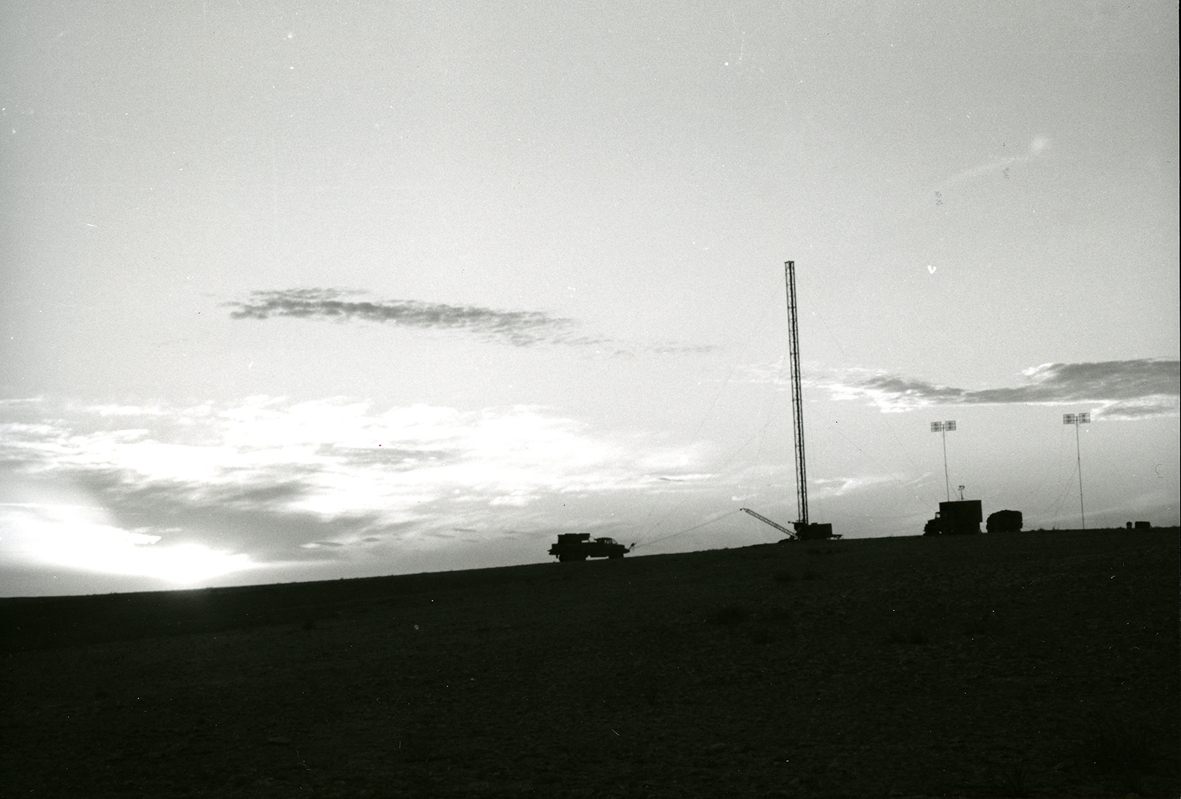
Military Service U.S. Air Force 1954-1959

Slide 10
Professional Organizations
Association of American State Geologists
Association of Missouri Geologists
Association of Environmental and Engineering Geologists
Association of State Dam Safety Officers
ASTM (mid 1990s through 2005)
Geological Society of America
Missouri Academy of Science
Midwest Groundwater Association
Missouri Geologists Consortium
Missouri Pilots Association St. Louis Chapter
FAA Airmen Certification

Slide 11
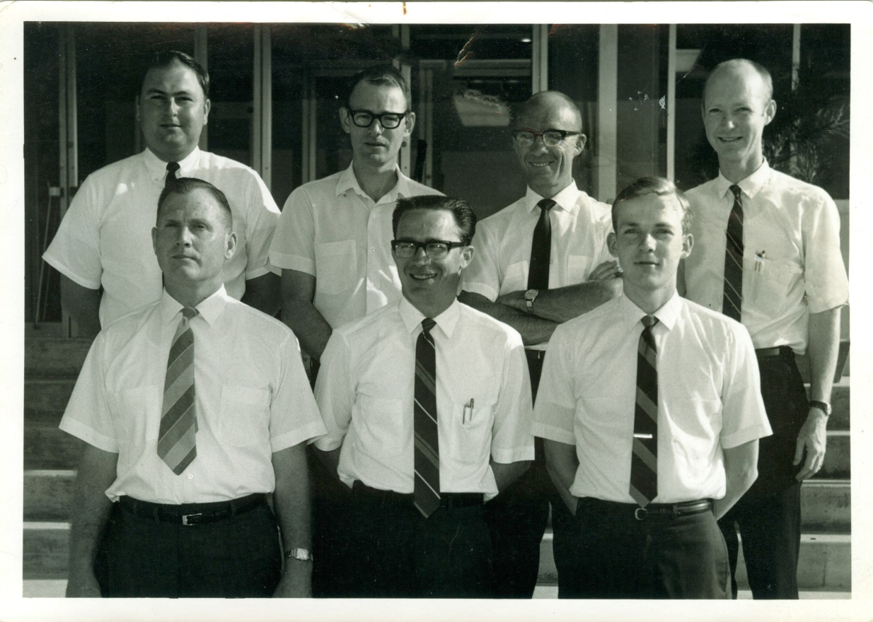
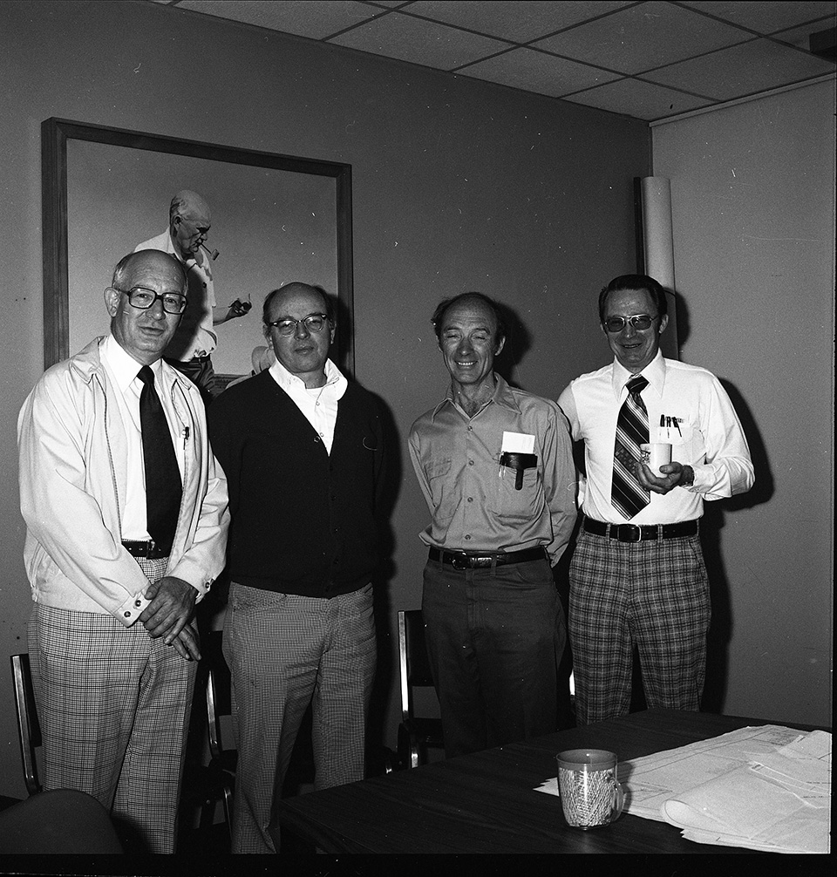
Early Career

Slide 12
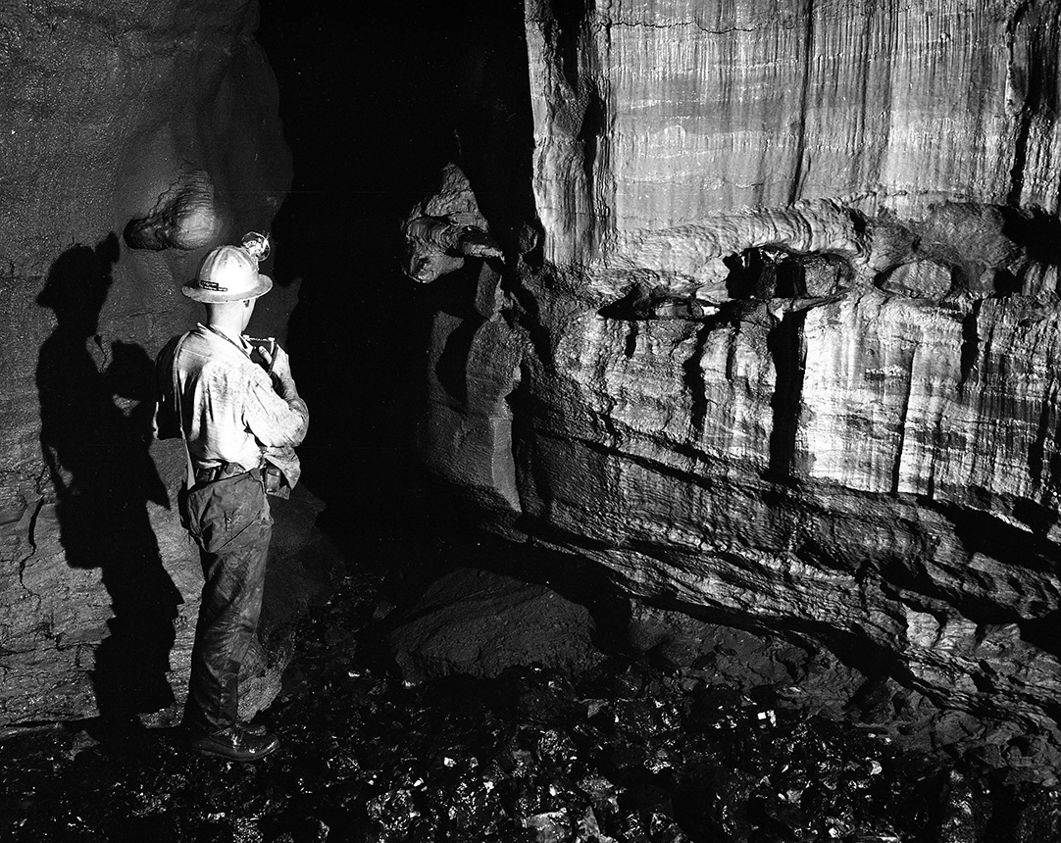
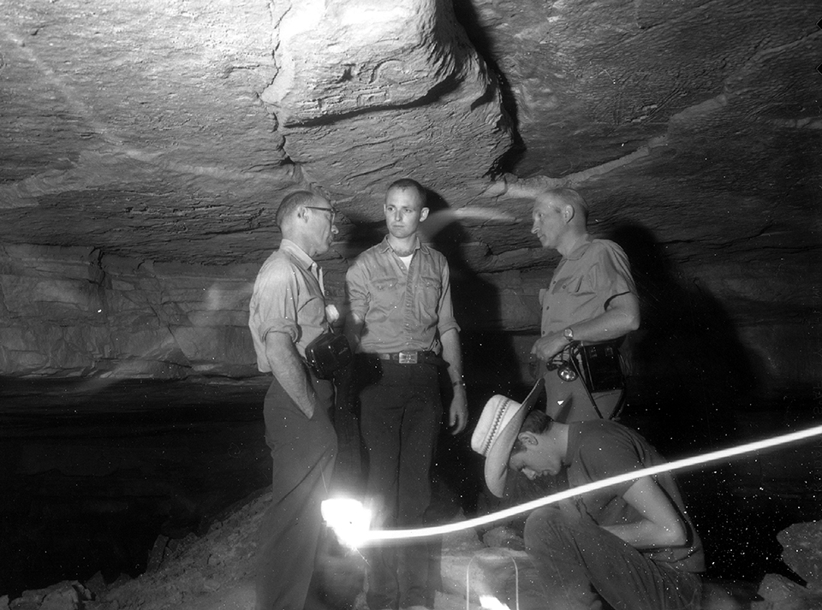
Early Career

Slide 13
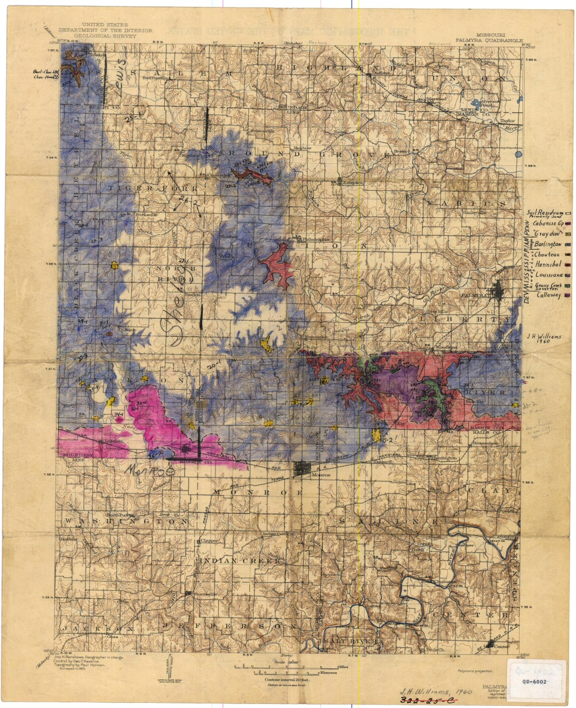
Early Career

Slide 14
Pilot

Slide 15
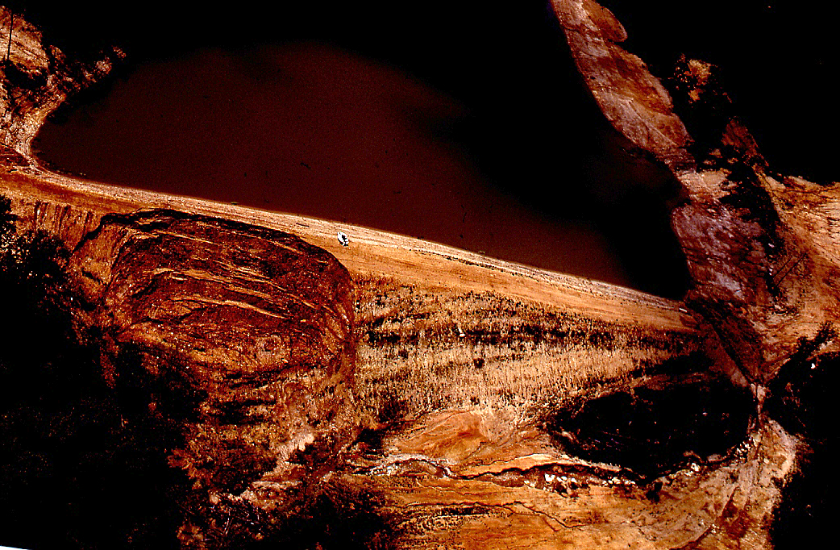
Pilot

Slide 16
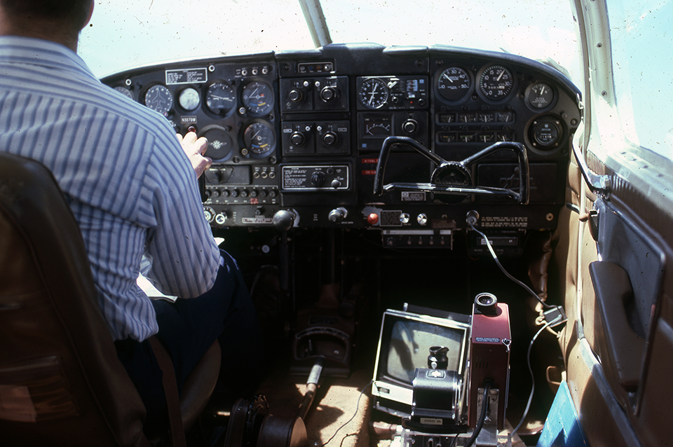
Flights of Interest

Slide 17
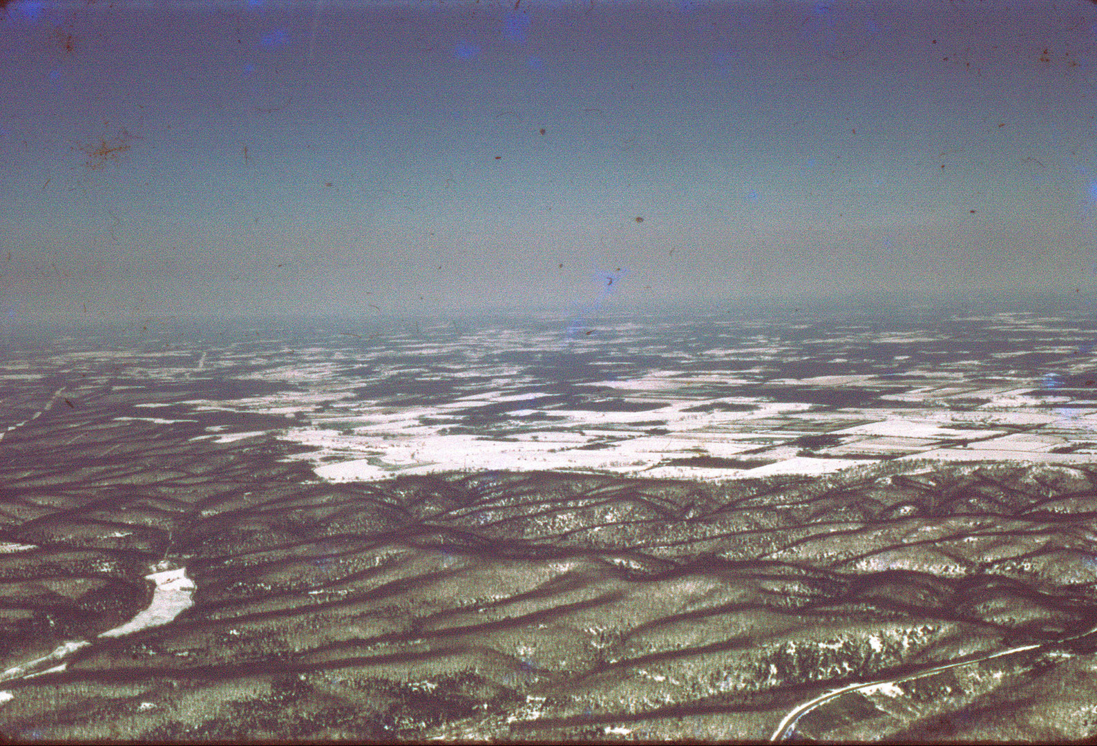
Flights of Interest Continued

Slide 18
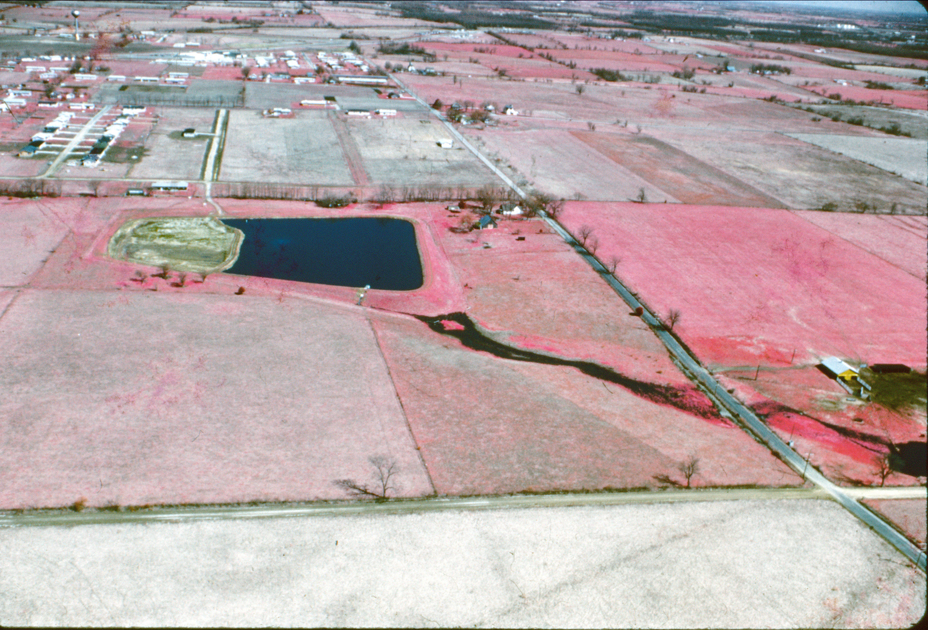
Flights of Interest Continued

Slide 19
Czechoslovakia

Slide 20
AEG Kansas City, St. Louis, and UMR

Slide 21
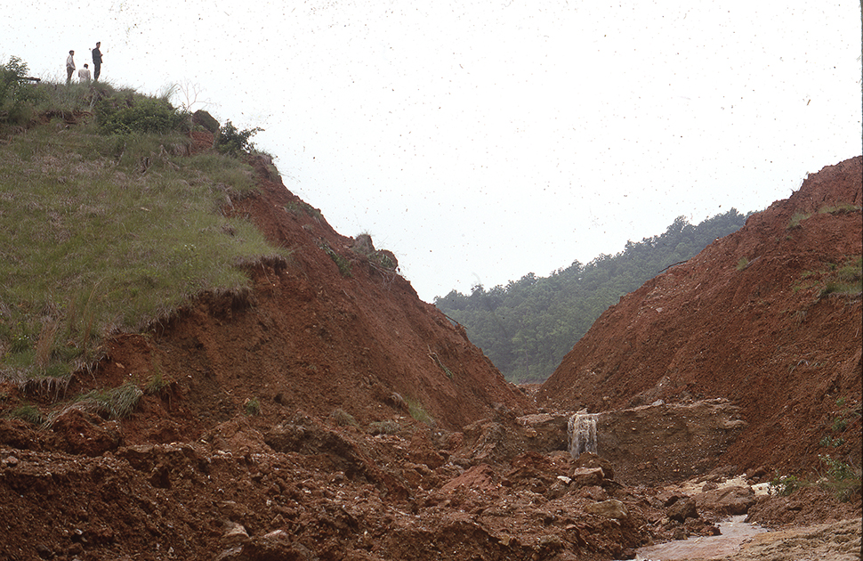
MGS Adds Engineering Geology

Slide 22
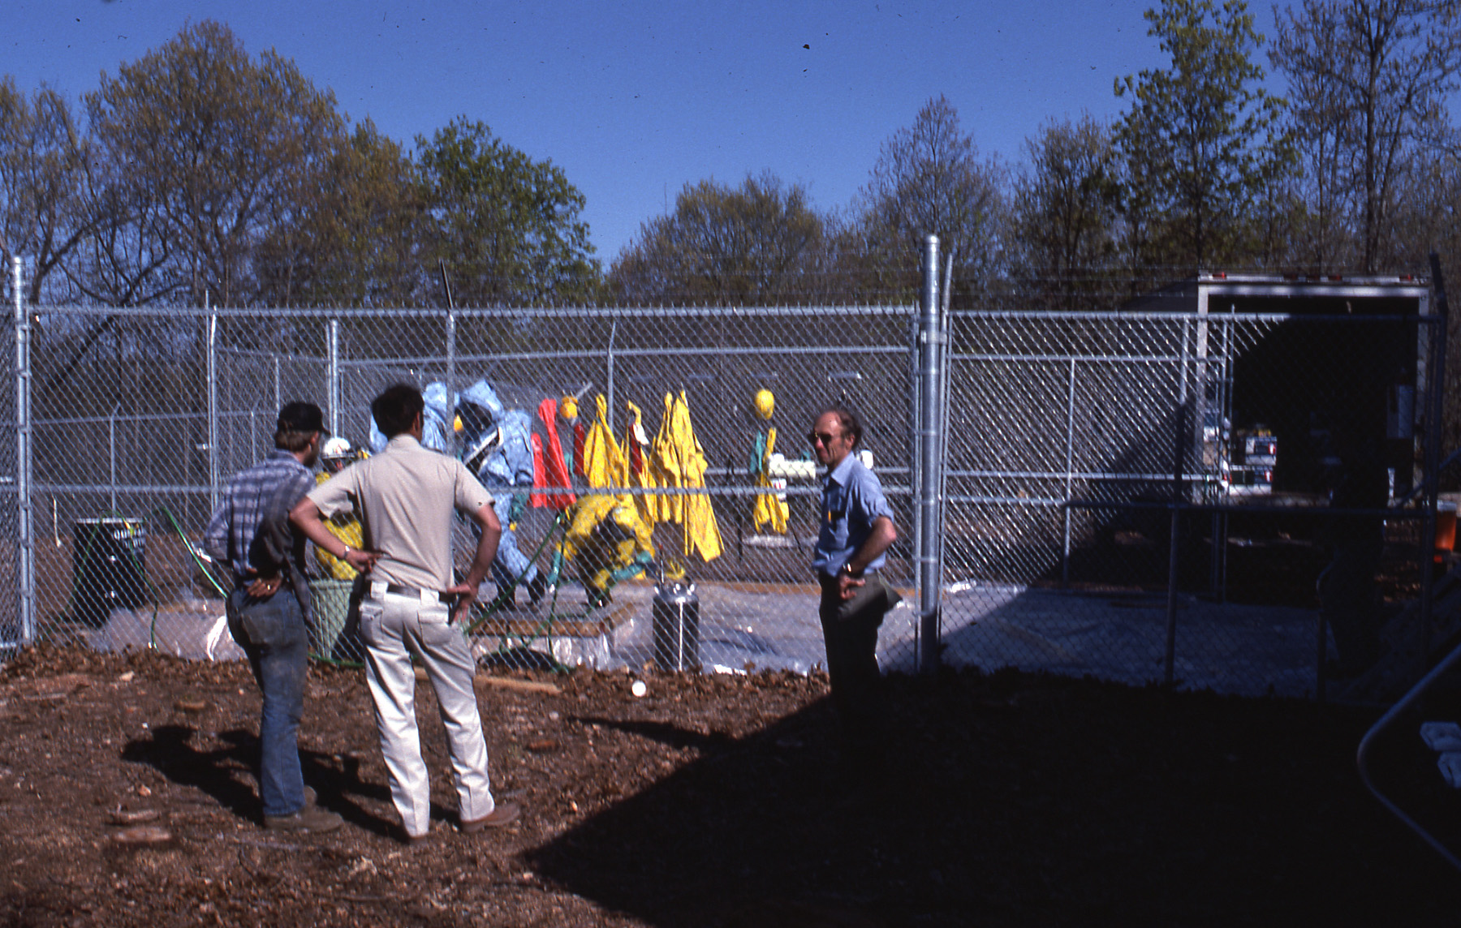
Superfund

Slide 23
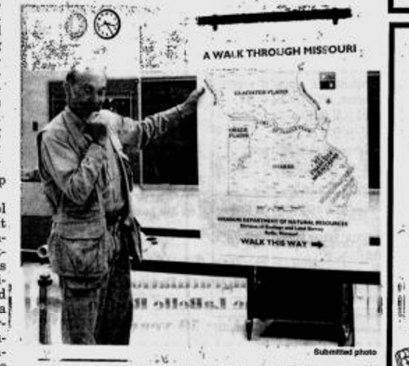
Jim’s National Work

Slide 24
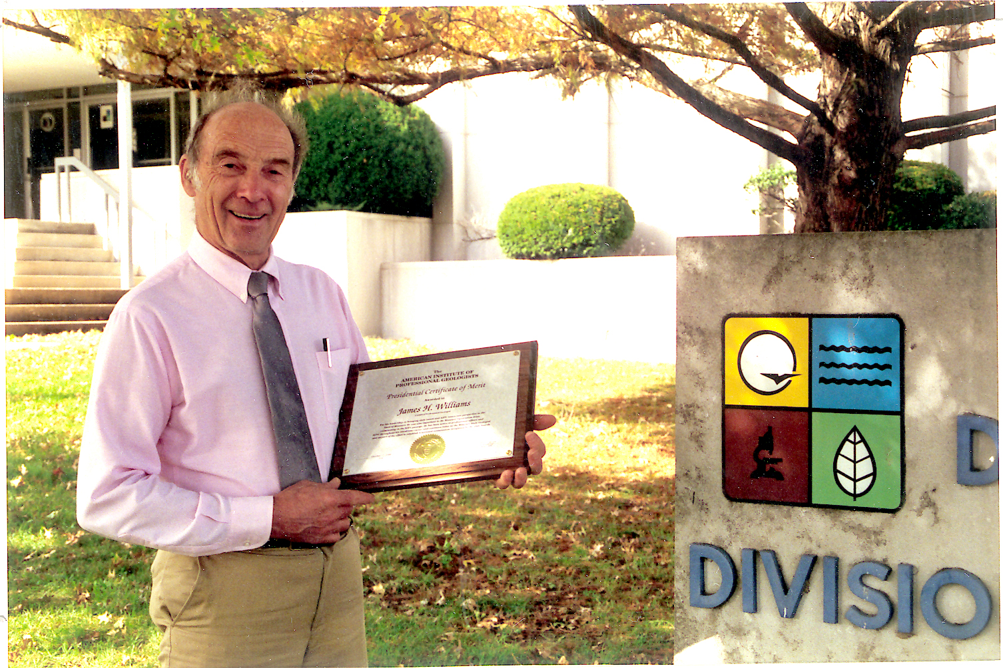
ASBOG

Slide 25
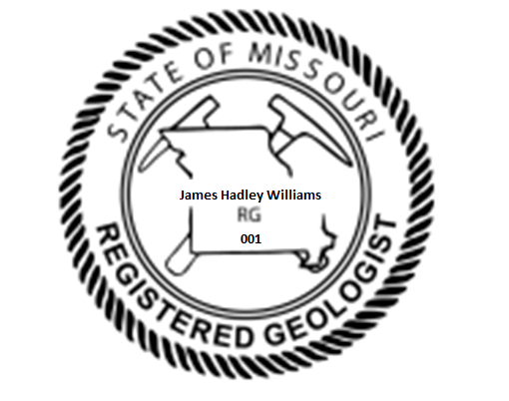
Registration

Slide 26
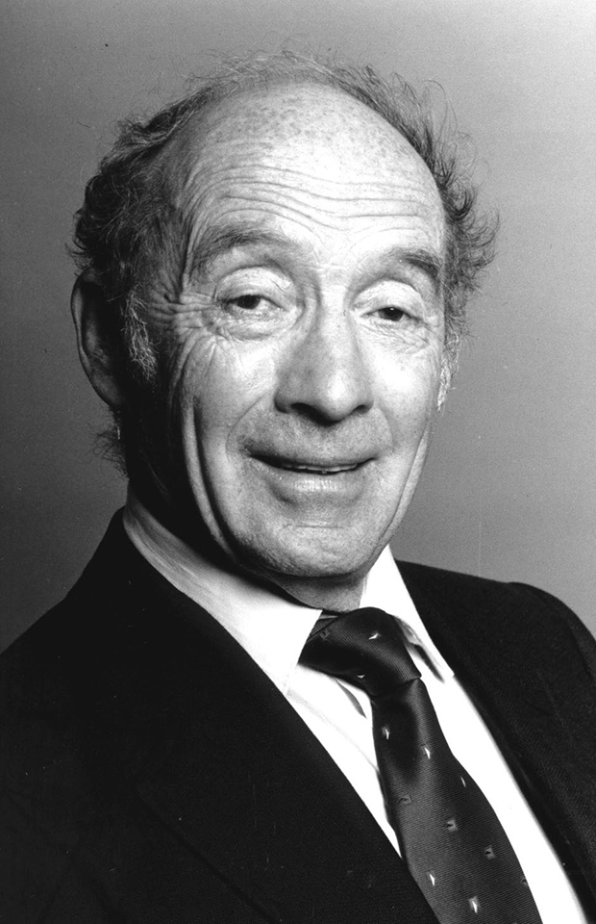
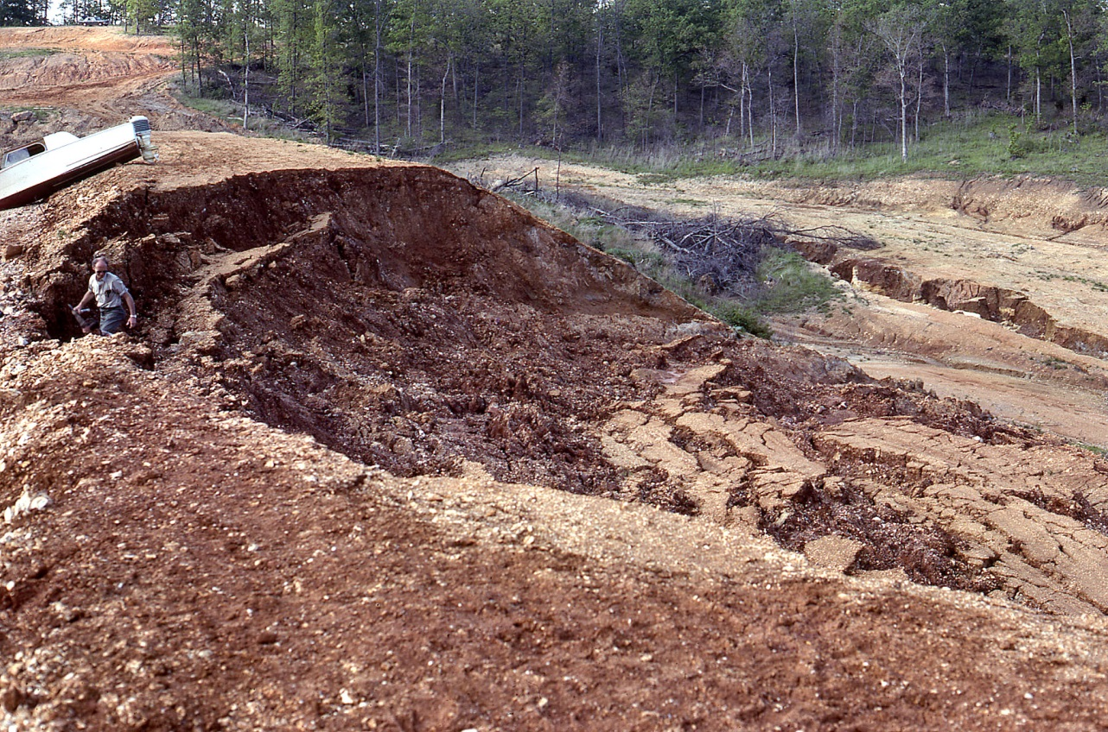
Professional Work as Division Director and State Geologist

Slide 27
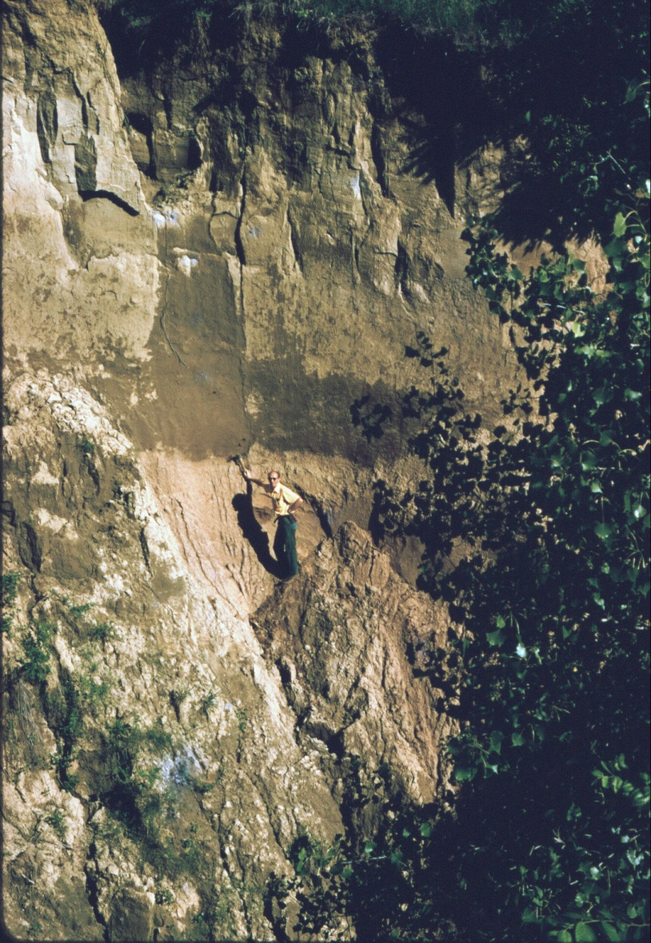
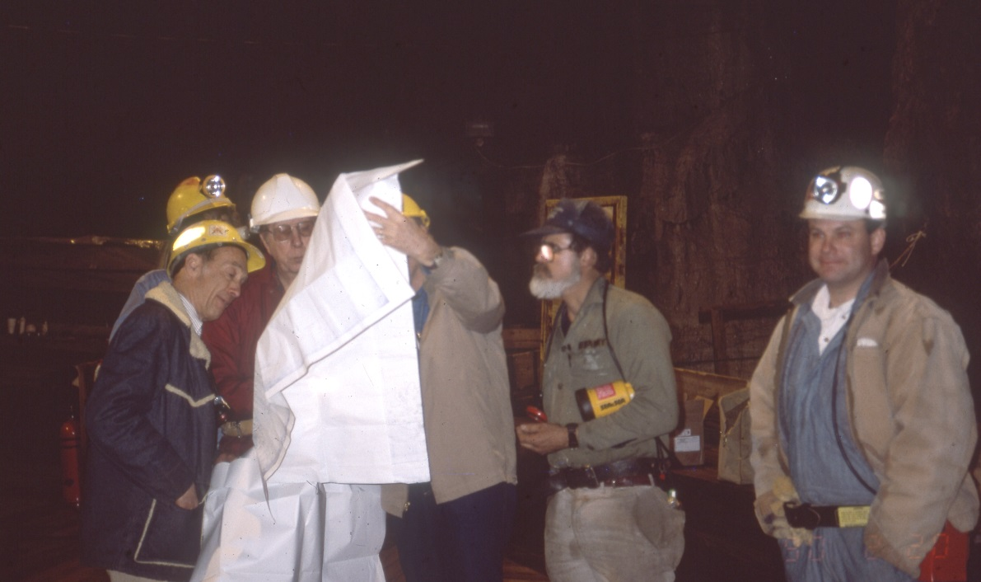
Director and State Geologist 1986 - 2000

Slide 28
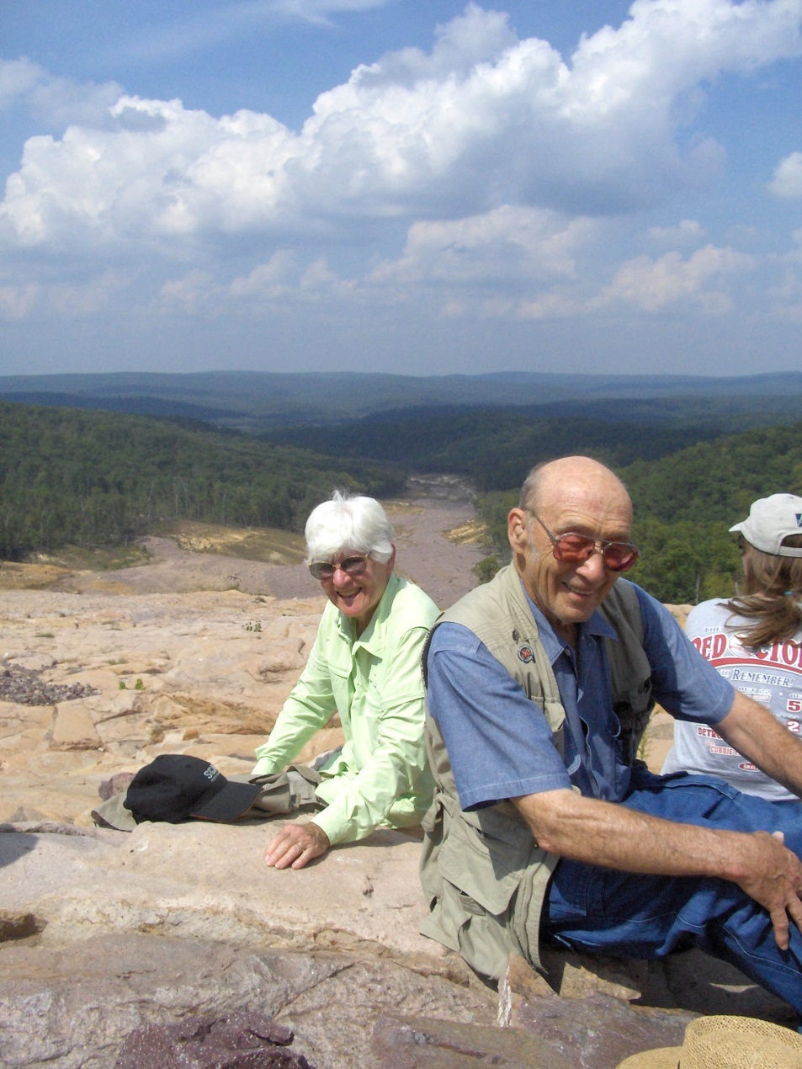
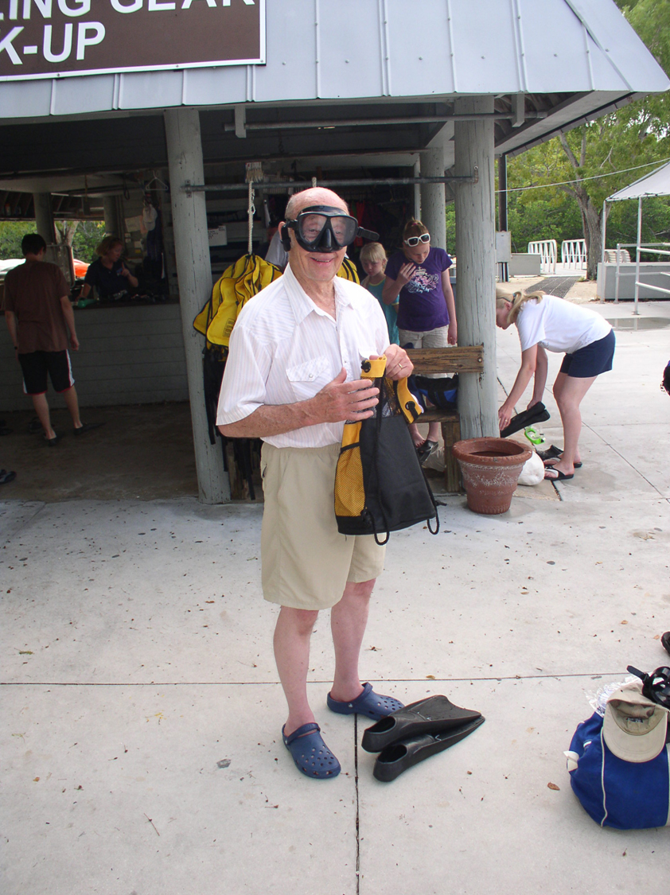
2000 - 2010 (Semi-Retired)

Slide 29
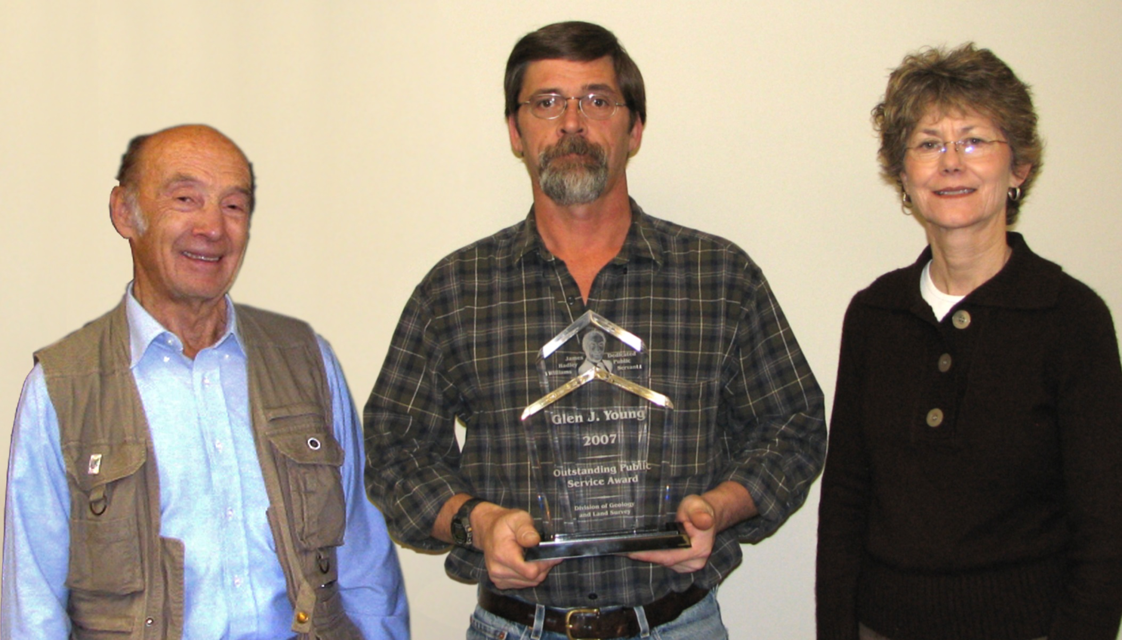
Jim with Mimi and Glen

Slide 30
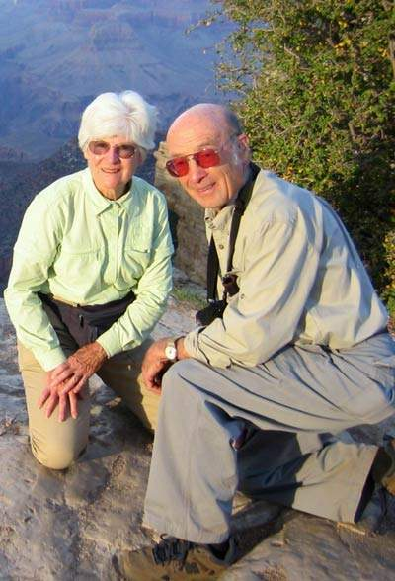
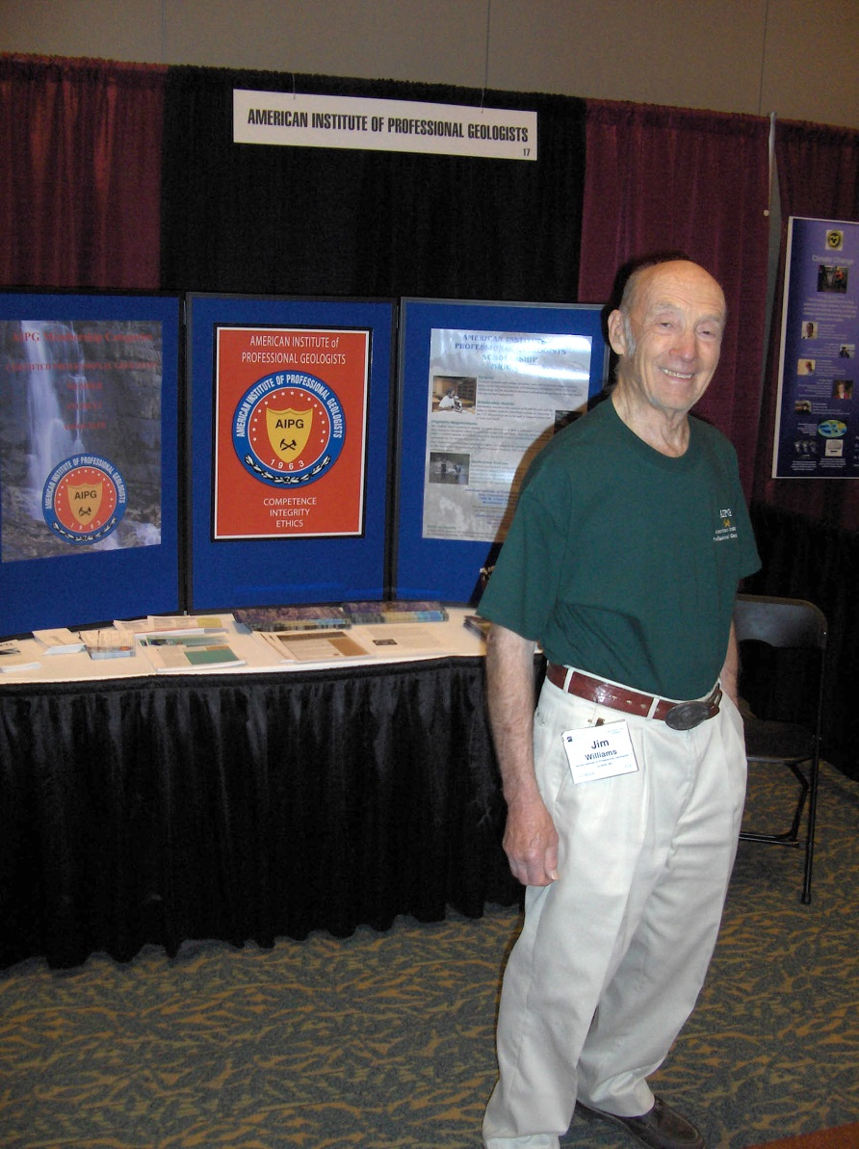
2010 – Present

